Slide 1



Exception Handling
www.cybage.com
Copyright © 2019 Cybage Software Pvt. Ltd. All Rights Reserved. Cybage Confidential. www.cybage.com

Slide 2
Agenda
What are Exceptions
OOP way of Exception Handling
Types of Exceptions
ARM – Automatic Resource Management
User Defined Exceptions
www.cybage.com

Slide 3
What is Exception
Exceptions are nothing but some anomalous conditions that occur during the execution of the program.
Exceptions are the conditions or typically an event which may either cause a running program to terminate or change its normal flow of execution
www.cybage.com

Slide 4

Hierarchy Of Exception Classes
Throwable is the super class in Exception hierarchy
It is in java.lang package.
The Throwable class is further divided into two subclasses :-
Throwable
Error
Exception
www.cybage.com

Slide 5
Error Class
Errors :
These are the situations which can not be handled or can not be recovered from.
•
If any such situation occurs, program will terminate.
Those situations are rare & usually fatal
Example: OutOfMemoryError
some internal error in JVM
www.cybage.com

Slide 6
Exception Class
Exceptions:
These are the situations which can be handled.
It is possible to recover from such situations & continue with program execution further.
However normal flow of execution may change in
such situations.
www.cybage.com

Slide 7
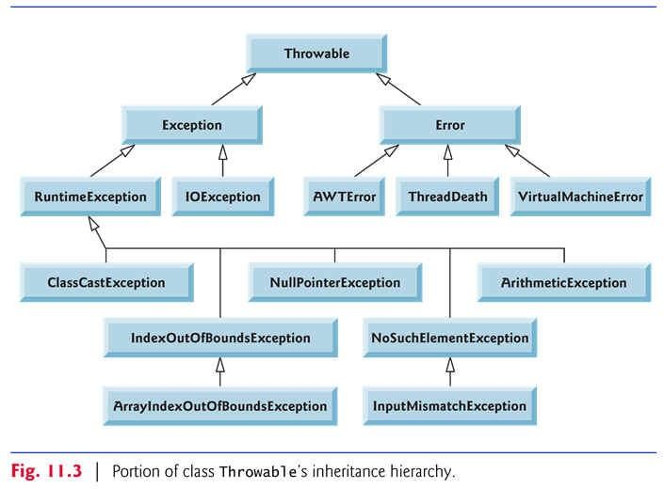
Exception Hierarchy
www.cybage.com

Slide 8
OOP Way of Exception Handling
The various keywords for handling exceptions are below.
try catch finally throw throws
The three exception handler components are used to catch and handle
the exceptions. These are try, catch and finally clause.
www.cybage.com

Slide 9
Syntax of Exception Handling
Using try and catch:
The syntax for the usage of try, catch and finally block is given
below.
try {
………
}
catch(<exceptionclass1> <obj1>){
………
}
finally{
………
}
www.cybage.com

Slide 10
Try Block
The code which is capable of generating some kind of
exception (Checked Exception) must be written in Try block.
Try block should be immediately followed by either a
finally block.
catch or
A try block can have multiple catch blocks
www.cybage.com

Slide 11
Catch Block
The Catch Block is used as exceptional-handler. The Exception that arises in the
try block is handled by the Catch -Block.
What is the problem with following code? try {
}
catch (RuntimeException re){
catch(NullPointerException catch (Exception e) {-----}
catch (Throwable t){----}
---} ne){---}
www.cybage.com

Slide 12
Finally Block
Finally block gets executed in either of the cases :
if Exception occurs or it does not occur
advantage : write clean up code in “finally”
www.cybage.com

Slide 13
Types Of Exceptions – Checked Exception
Checked Exceptions: Those are the exceptions where compiler will ensure that programmer has handled those situations.
The code capable of generating such kind of exception has embedded in Try- catch block or compiler
will complain (or method where this code resides should declare it in “throws” clause)
to be
Example : IOException , SqlException
www.cybage.com

Slide 14
Types Of Exceptions – Unchecked Exception
Unchecked Exceptions:
Compiler will not check whether programmer has handled those situations or not.
Example:
all RunTimeExceptions
www.cybage.com

Slide 15
How to throw Exception in Java
Whenever an exceptional situation occurs, an object
of that particular Exception is created & thrown.
We can also create an Exception object & explicitly throw it using keyword “throw”
Example:
try{
if( …some condition) throw new Exception();
}
catch(Exception e)
{
…….some handling code
here
}
www.cybage.com

Slide 16
Important points
If the method throwing a checked exception does not catch it then method must declare it as throws that exception
Exceptions can cascade from a method to its caller & so on till
main() method throws that exception.
An overridden method in subclass can not throw more checked
exception than the original method in super class
www.cybage.com

Slide 17
ARM – Automatic Resource Management
Resources such as Connections, Files, Input/OutStreams , etc. should be closed manually by the developer by writing bog-standard code.
Usually we use a try-finally block to close the respective resources.
See the current practice of creating a resource, using it and finally closing it:
try(resources_to_be_cleant) {
// your code
}
www.cybage.com

Slide 18
Multi-Catch
There are a couple of improvements in the exception handling area.
Java 7 introduced multi-catch functionality to catch multiple exception types using a single catch block.
public voidnewMultiCatch()
{
try{
methodThatThrowsThreeExceptions();
}
catch(ExceptionOne | ExceptionTwo | ExceptionThree e) {
// log and deal with all Exceptions }
}
}
www.cybage.com

Slide 19
User Defined Exception
Sometimes you may need to handle certain situations which are specific to your application.
In such cases, you can create your own User Defined Exceptions.
Example:
class InsufficientBalanceException extends Exception {
}
www.cybage.com

Slide 20
User Defined Exception
public void withdraw(int amt)
{
try{
if (balance < amt)
throw new InsufficientBalanceException();
}
catch(InsufficientBalanceException e)
{ handling code// some msg…}
}
www.cybage.com

Slide 21

www.cybage.com

Slide 22
Thank You!
Any Questions ?
www.cybage.com
Copyright © 2019 Cybage Software Pvt. Ltd. All Rights Reserved. Cybage Confidential._{6/4/2021} www.cybage.com 22

